Slide 1
2024 Nade national training conference everything you wanted to know about PFTs (but were afraid to ask) A presentation by J. Scott Pritchard, DO

Slide 3
Objectives
What are Respiratory Disorders?
Differentiate between Obstructive vs. Restrictive Lung disease
Cystic Fibrosis
Bronchiectasis
Pulmonary Function Testing
Other tools to assess severity and associated functional impact

Slide 4
Respiratory Disorders Listing 3.00
Any lung disorder that interferes with moving air out (obstruction) or moving air in(restriction) or diffusion (gas exchange) across the cell membranes in the lungs.

Slide 5
Chronic Obstructive Pulmonary Disease (COPD) –
Chronic bronchitis, emphysema
Pulmonary Fibrosis
Pneumoconiosis – coal worker’s (black lung), asbestosis, silo filler's lung,
talcosis, silicosis (grinder’s disease), etc.
Cystic Fibrosis
Bronchiectasis
Pulmonary Hypertension
Respiratory Failure
Lung transplantation

Slide 6
Symptoms
Coughing
Chest pain
Dyspnea – shortness of breath. At rest or with exertion
Wheezing
Sputum production
Hemoptysis (coughing up blood)
Use of accessory muscles
Tachypnea – increase rate of breathing.

Slide 9
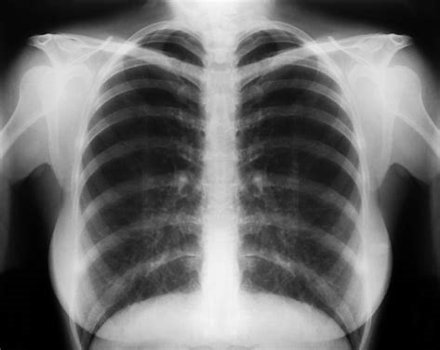

Slide 10
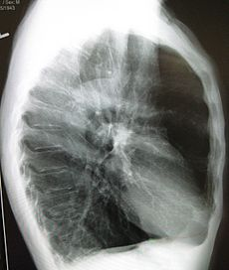

Slide 11
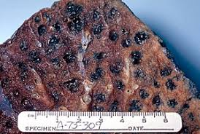

Slide 17
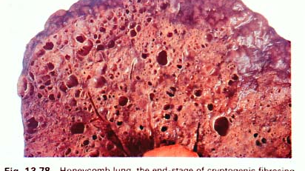

Slide 22
Cystic Fibrosis
- Hereditary – autosome recessive – 39000 in US (1.17%)
- CFTR gene mutation – (Cystic Fibrosis Transmembrane
conductance regulator)
- Affects mucus, sweat and digestive enzymes (exocrine glands)
- Thick mucus in the lungs/infection, poor growth, fatty stools,
clubbing of the digits and diabetes
- Listing 3.04 – Separate tables, listings for growth and DM(DC)

Slide 23
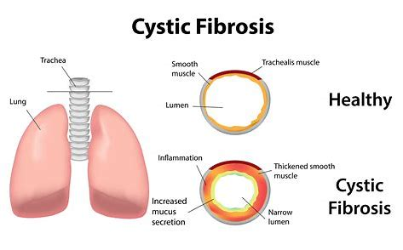

Slide 24
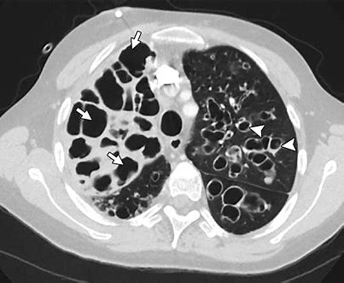

Slide 25
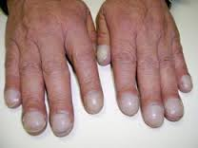

Slide 26
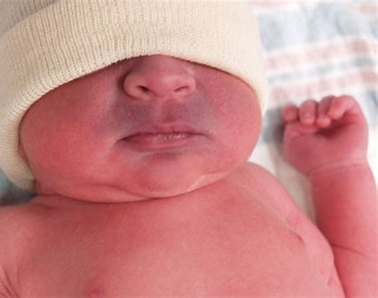

Slide 31
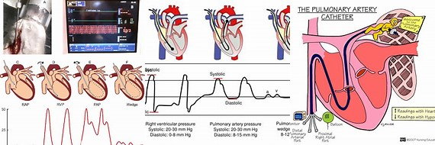

Slide 32
Spirometry
FEV1 – the volume of air exhaled during the first second of the
forced expiratory maneuver. Must last six seconds or 1
second on a plateaued curve
FVC - the total volume of air exhaled during the forced expiratory
maneuver
FEV1/FVC – ratio of the FEV1/FVC in percentage.
Single breath uncorrected DLCO (diffusion in liters of carbon monoxide)
IVC/FVC ratio – 85% or greater

Slide 33
Requirements
Height w/shoes or wing-span for severe kyphoscoliosis
Weight and Gender
Comment upon Effort and Cooperation with testing.
Legible tracings of each forced expiratory maneuver
- three pre-bronchodilator tracings (flow volume loops)
- three post-bronchodilator tracings (flow volume loops)
Use the best FEV1 or FVC even if not from the same tracing

Slide 34
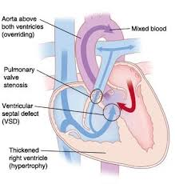
Period of Stability
Within two-weeks after a change in medication for a respiratory disorder
Within 30 days of completion for treatment of a LRI (lower respiratory tract infection)
Within 30 days of treatment for an exacerbation of a chronic respiratory disorder
Hospitalized or within 30 days of a hospital discharge for myocardial infarction

Slide 35
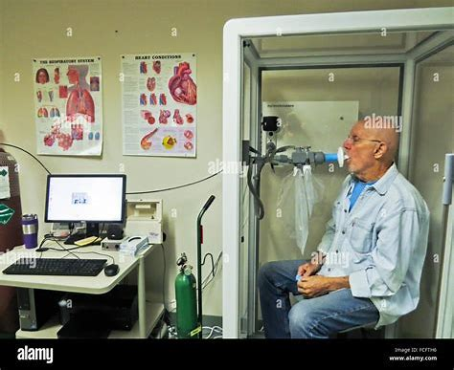

Slide 37
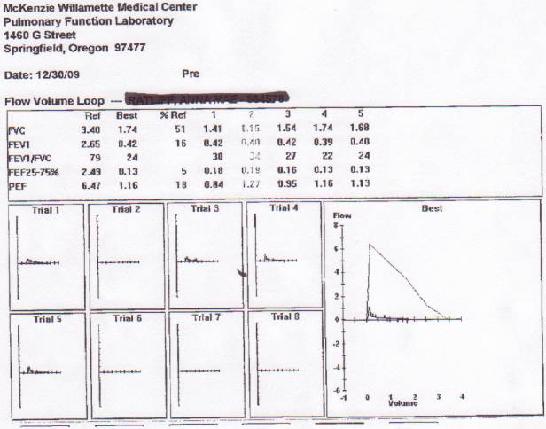

Slide 38
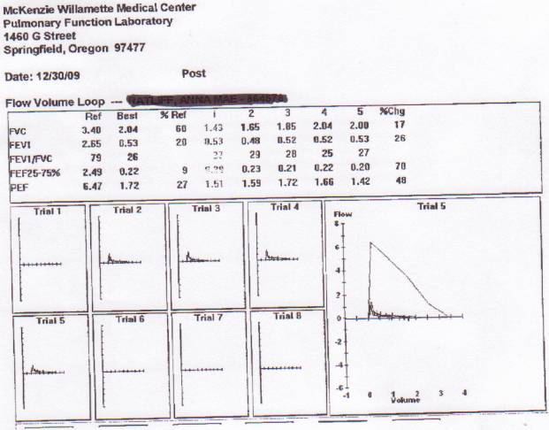

Slide 39
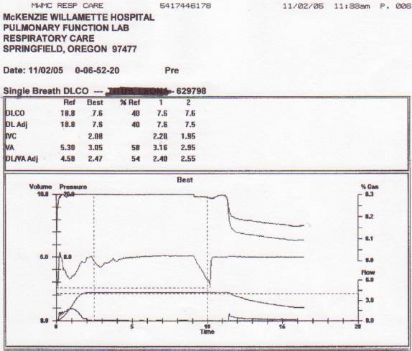

Slide 40
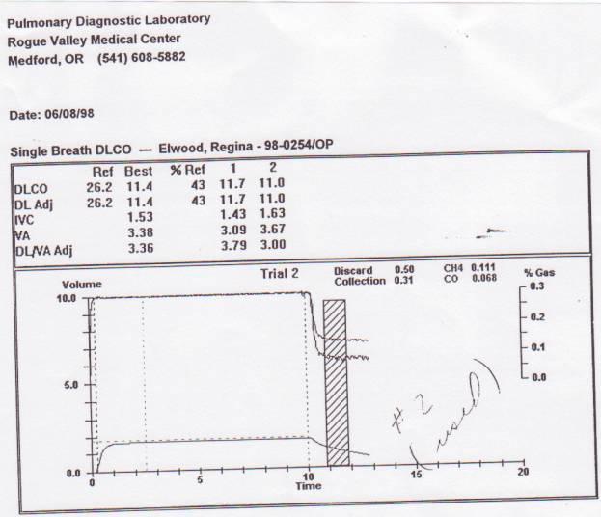

Slide 41
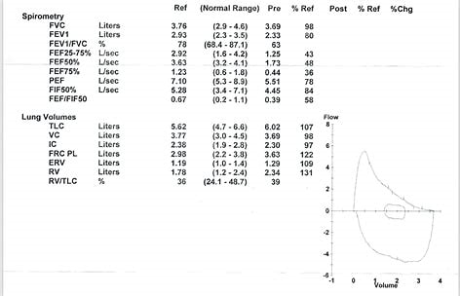

Slide 42
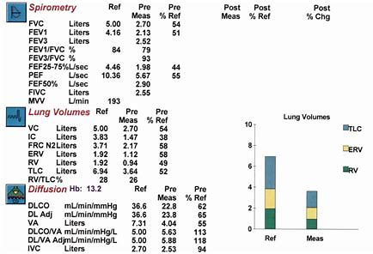

Slide 43
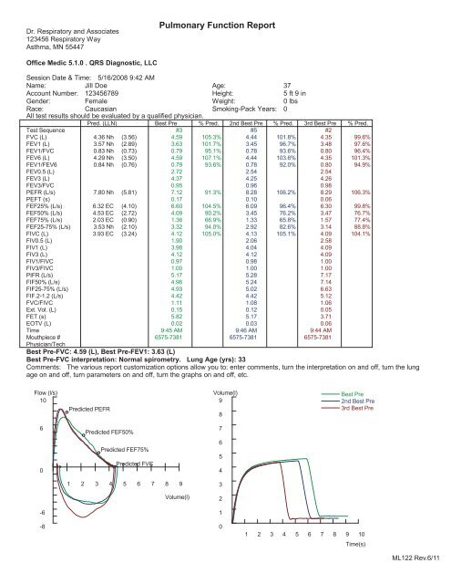

Slide 44
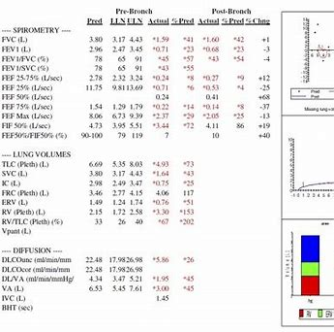

Slide 45
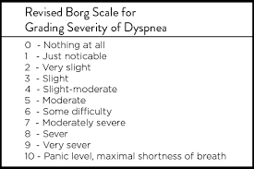

Slide 47
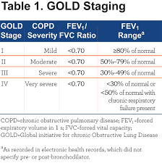

Slide 48
Oximetry –
6 MWT – use the lowest recorded SaO2 on room air (RA)
Listing 3.02 C3 - Table V
Test site altitude (feet above sea level) | SpO₂ less than or equal to
Less than 3,000 | 87 percent
3,000 through 6,000 | 85 percent
Over 6,000 | 83 percent

Slide 49
A 60-year-old clt presented with progressive shortness of breath and
chronic non-productive cough. The clt reported a 45-year history of smoking
2 packs of cigarettes per day (90 pack years).
The clt reported mMRC – 3 dyspnea. SaO2 on RA – 92%. CXR – hyperinflation
with flattened diaphragms. No lesion or consolidations.
Breath sounds diminished in the bases to auscultation. Minimal expiratory
wheezing. The clt able to speak in clear sentences

Slide 50
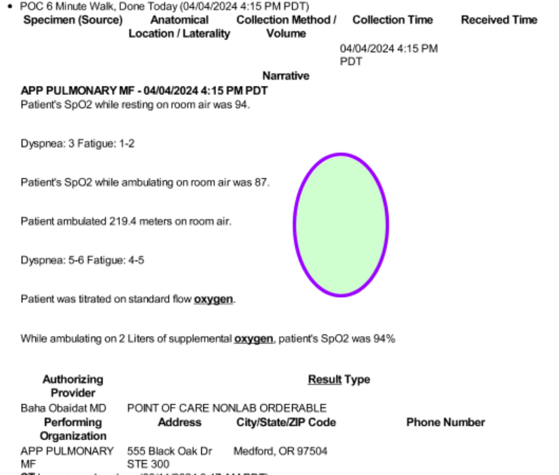

Slide 51
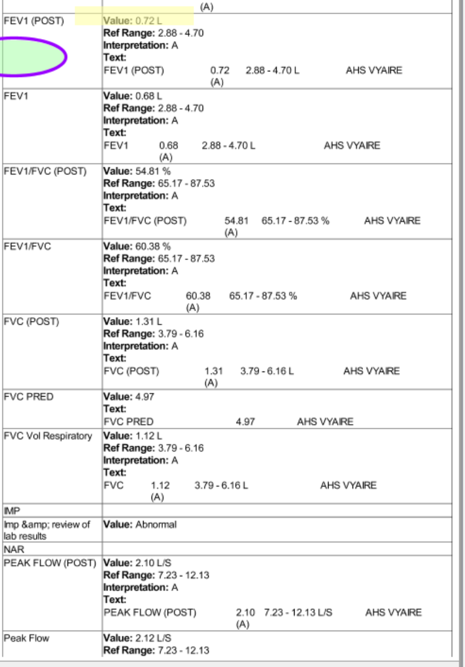

Slide 53
Thank you for your kind attention!

