Slide 1
Pediatric Puzzlers
Making sense of early childhood medical evaluations
Dr. Hall
August 5, 2024

Slide 2
Objectives
Review the basics of child development
Understand the impacts of prematurity
Interpret early childhood screenings and assessments
Apply our learning to three cases
Summarize key learning points
Questions
Resources
References - embedded throughout

Slide 3
Child Development Basics

Slide 4
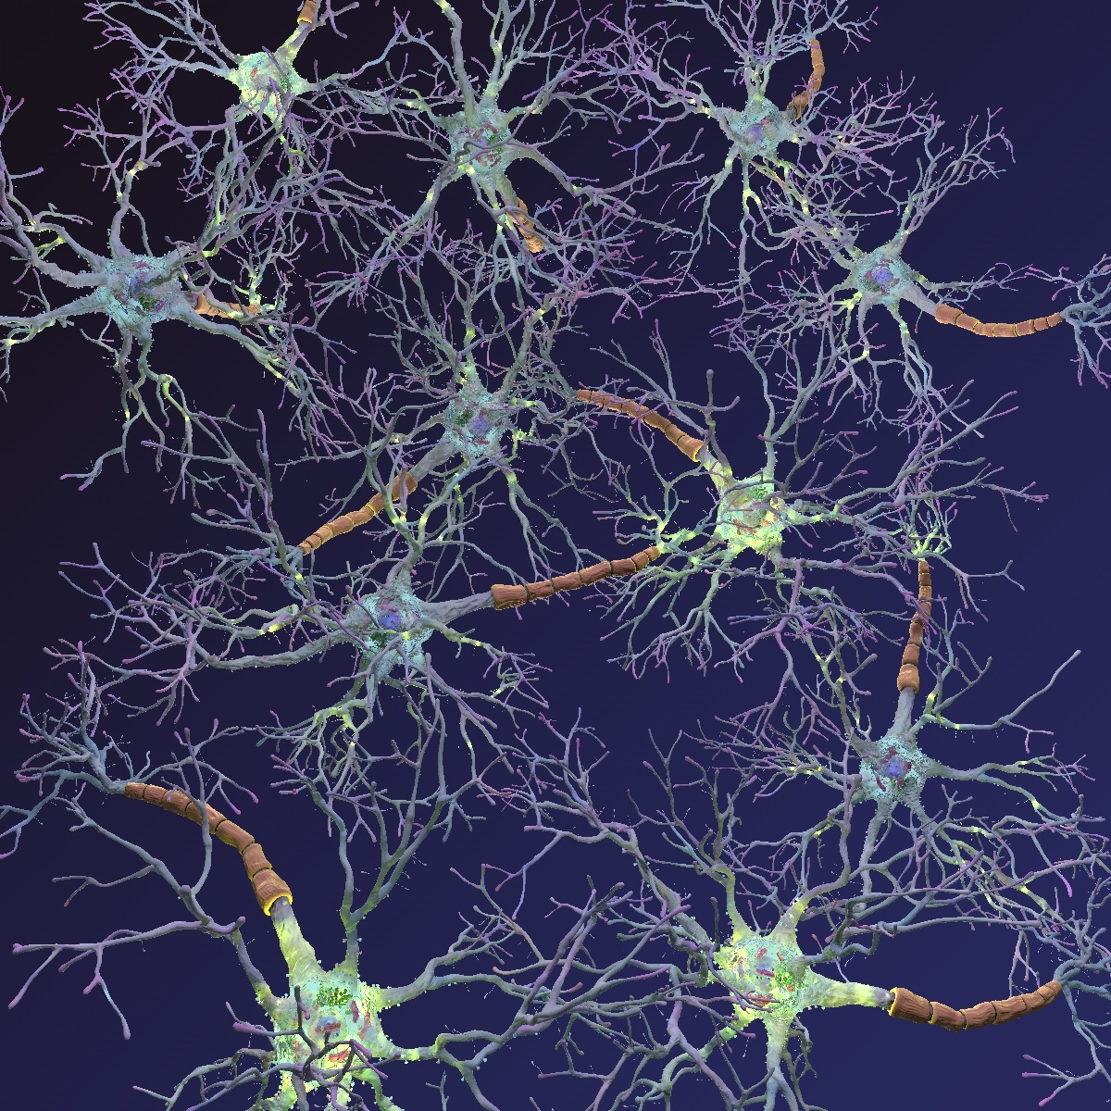
Early Childhood Development

Slide 5
Early Childhood Development
0 - 3

Slide 6
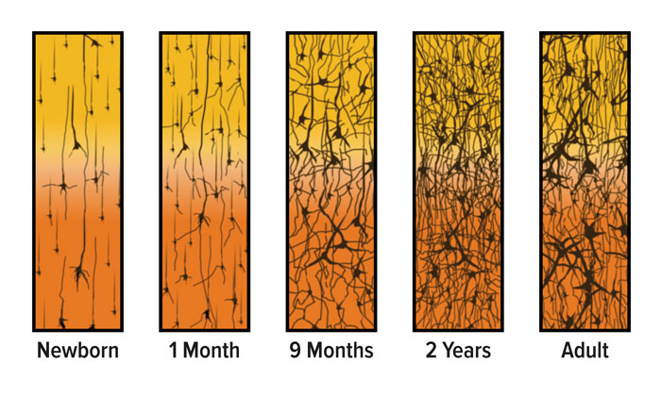
Neuronal Connections By Age
Source: urbanchildinstitute.org

Slide 7
SERVE
RETURN
NEURON GROWTH
Source: pittsburghparent.com

Slide 8
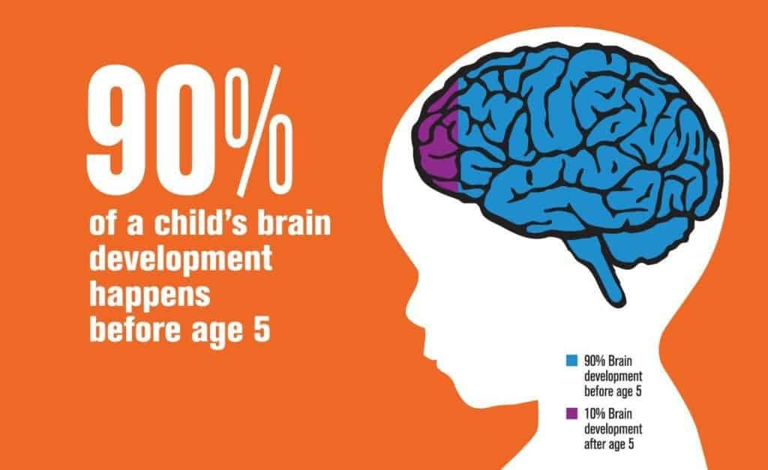

Slide 10
SERVE
RETURN
NEURON GROWTH
Source: pittsburghparent.com

Slide 11
Source: Google images

Slide 12
SERVE
RETURN
NEURON GROWTH
Source: pittsburghparent.com

Slide 13
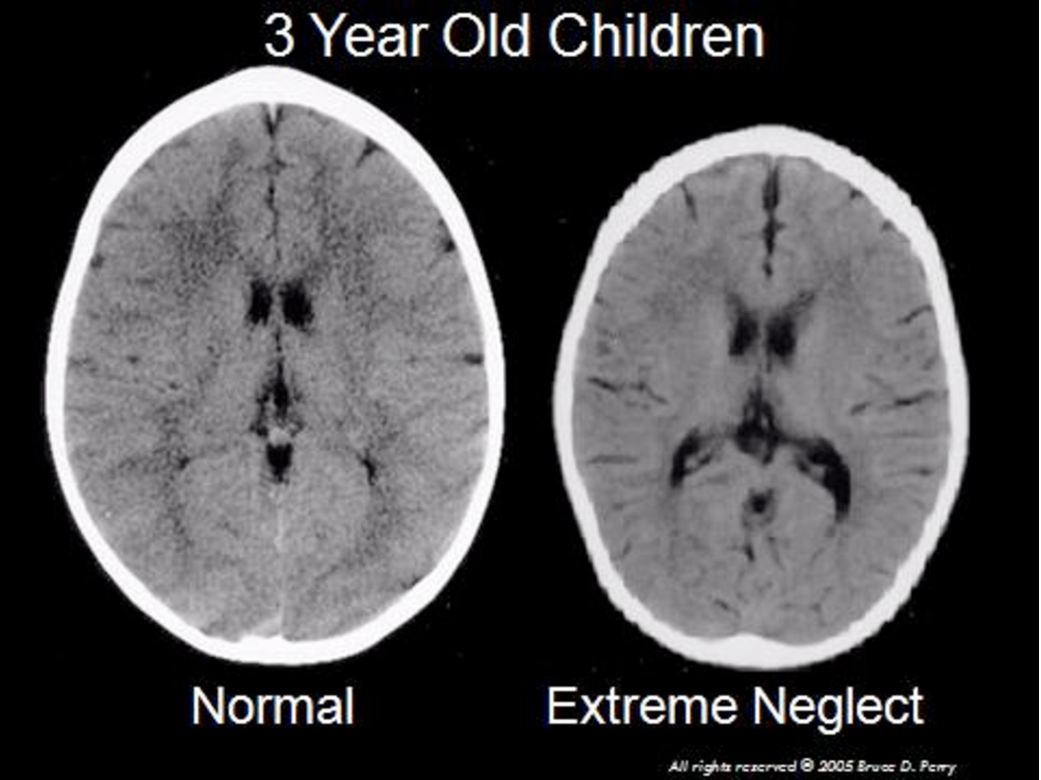
Source: Perry “Child Maltreatment: a Neurodevelopmental Perspective on the Role of Trauma and Neglect in Psychopathology.” .

Slide 14
Impacts of Stress on Neuronal Development in Young Children
Source: Radley et al (2004); Bock et al (2005). Credit: Center on the Developing Child.

Slide 15
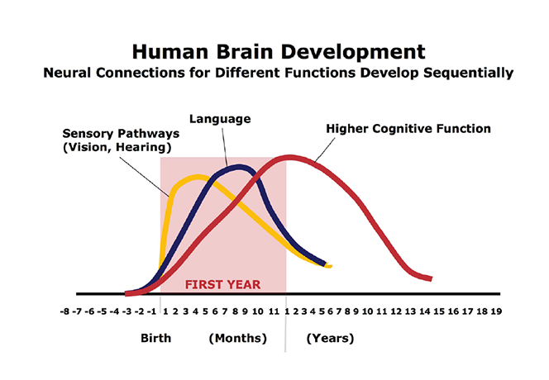
Source: C.A. Nelson (2000). Credit: Center on the Developing Child

Slide 16
Neuronal Connections By Age
Source: urbanchildinstitute.org

Slide 17
Early Intervention Services (EIS)
Services and supports that are available to babies and young children with developmental delays and disabilities and their families.
May include speech therapy, physical therapy, occupational therapy based on child’s needs
Significant impact on a child’s ability to learn new skills and overcome challenges
Programs are available in every state and territory

Slide 18
Optimizing Neuronal Catch Up Growth
Source: "BRAIN POWER: From Neurons to Networks" http://www.letitripple.org

Slide 19
Benefits of Early Intervention
Source: Early Intervention Foundation

Slide 20
Impacts of Prematurity

Slide 21
Source: Freepik.com

Slide 22
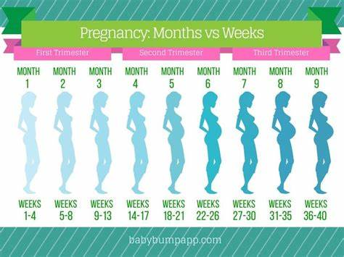

Slide 23
Infant born at 24 weeks
40 – 24 = 16 weeks early
= 4 months

Slide 24
24 weeker now 4 months of age
Milestones?
Newborn

Slide 25
24 weeker now 10 months of age
Milestones?
6 months

Slide 26
24 weeker now 2 years of age
Milestones?
2 Years

Slide 27
Source: C.A. Nelson (2000). Credit: Center on the Developing Child

Slide 28
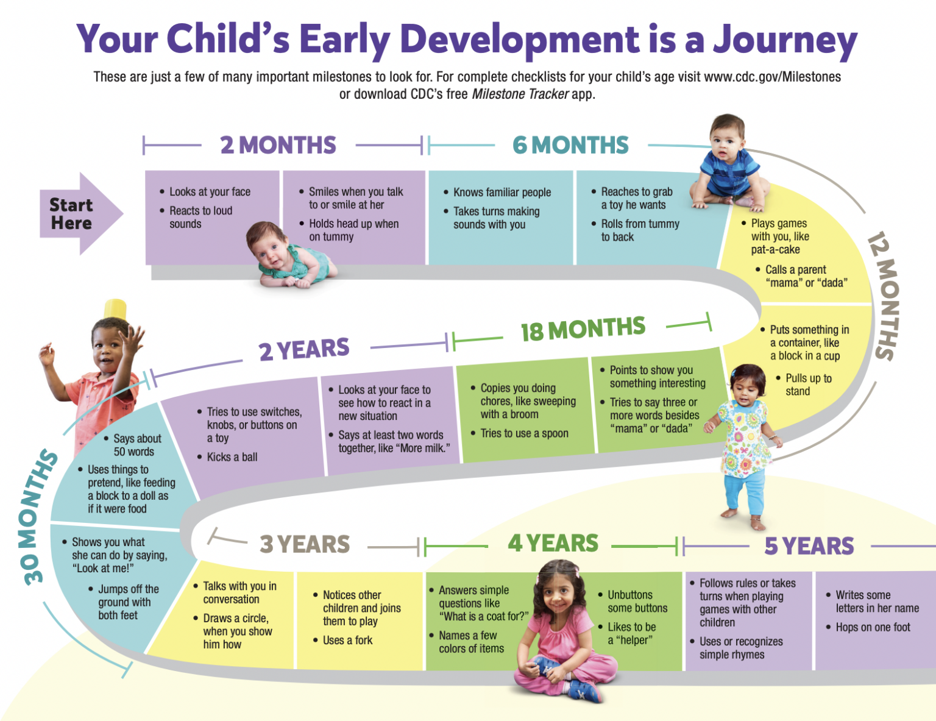
CDC Developmental Milestones

Slide 29
Childhood Developmental
Screening & Assessments

Slide 30
Considerations to Childhood Assessments
MANY
Who is completing it?
What bias may be present?
Stages of grief/acceptance?
Scoring
Factor in prematurity
Overall picture?

Slide 31
Case Application

Slide 32
Case #1
8 month old infant
Former 30 week premature infant
Abnormal head shape
CT imaging: craniosynostosis of sagittal suture
Not yet sitting independently

Slide 33
Case #1: 8 mo former 30 weeker abnormal head shape
?

Slide 34
Case #1: 8 mo former 30 weeker abnormal head shape
10 weeks early = 2.5 months delay expected
5.5 months corrected age
Developmental screenings?
Participating in early intervention?
Surgical plans?

Slide 35
Case #2
20 month old
Former 23 week premature infant
Retinopathy of prematurity
G-tube, history of reflux
Graduated from OT, PT, & speech therapy

Slide 36
Case #2: 20 mo former 23 weeker
Extreme prematurity
?

Slide 37
Case #2: 20 mo former 23 weeker extreme prematurity
17 wks early = 4 mo + 1wk delay expected
16 months corrected age
Developmental screenings?
G-tube use
Vision
Weight trajectory

Slide 38
Case #3
4 year old
Former 32 week premature infant
Intrauterine drug exposure: opioids
Allegations: behavioral concerns, anger, aggression

Slide 39
Case #3: 4 yo former 32 weeker
Intrauterine opioid exposure
?

Slide 40
Case #3: 4 yo former 32 weeker
Intrauterine opioid exposures
Prematurity no longer relevant
Developmental screenings?
Preschool?
Medical issues: vision + hearing?
Neglect history, foster care experiences?

Slide 41
Key Points
Childhood Development is ALL about developing healthy neuronal networks
Early childhood neuronal development sets the stage for all future learning potential
Prematurity, sedation, hospitalizations, neglect, abuse, stress all impact childhood neurons developing
There are lots of developmental assessments
Focus on who is filling out the assessment and what the findings could suggest
One piece of a puzzle to form a bigger picture
Abnormal head shape is not always associated with developmental delay
Prematurity requires ‘corrected gestational age’ until 2 years of age for milestone references
There is an association with intrauterine drug exposures (opioids) and hearing/vision abnormalities

Slide 42
Questions?

Slide 43
Resources
CDC’s Developmental Milestones
Center on the Developing Child – Harvard University
Zero to Three

Slide 44
Thank YOU for your attention & interest
Emily Hall, DO, FAAP
Emily.Hall.DO@ssa.gov

